Slide 1
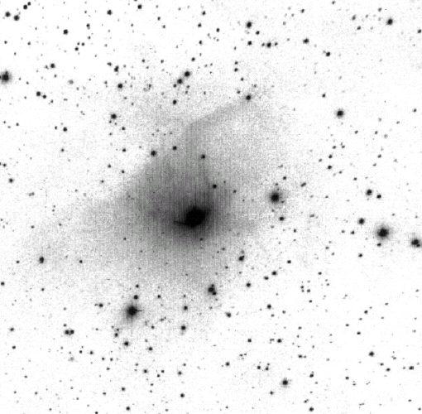
FU Ori and Outburst Mechanisms
Zhaohuan Zhu
Hubble Fellow, Princeton University
Collaborators: Lee Hartmann (Umich), Charles Gammie (UIUC),
Nuria Calvet (Umich), Jonathan McKinney (UMD),
Jaehan Bae (Umich)

Slide 2
Outlines
  FU Ori observations
  -High accretion rate inner disks
  Outburst mechanisms
  -MRI+GI
  -Disk fragmentation
R*

Slide 3
FU Ori
Class I/II
FU Orionis objects
Boundary layer
Star
Disk
F
Light from disk accretion
λ

Slide 4
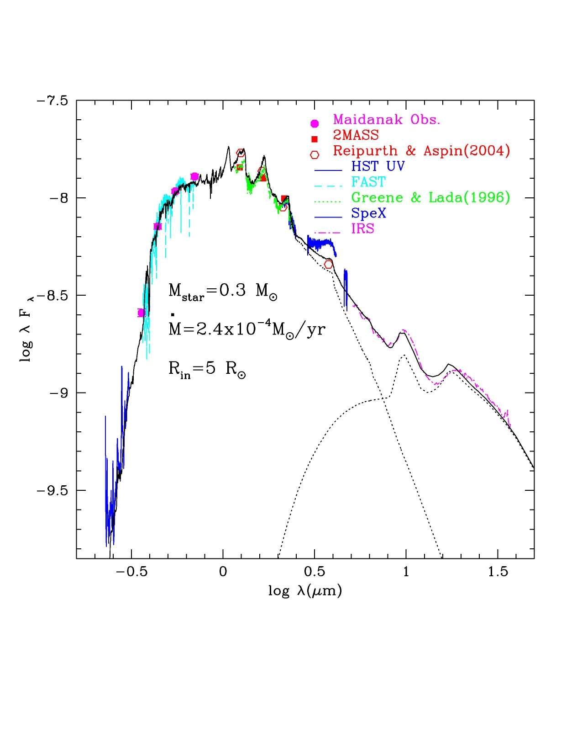




FU Ori
What can we learn from SED?
Hartmann & Kenyon 1985, 1987
Kenyon, Hartmann & Hewett 1988
K,M
Constant dM/dt inner disk
F,G
High mass accretion disk
Spectral type:
Luminosity :
Zhu et al. 2007
Double peaked absorption lines:

Slide 5
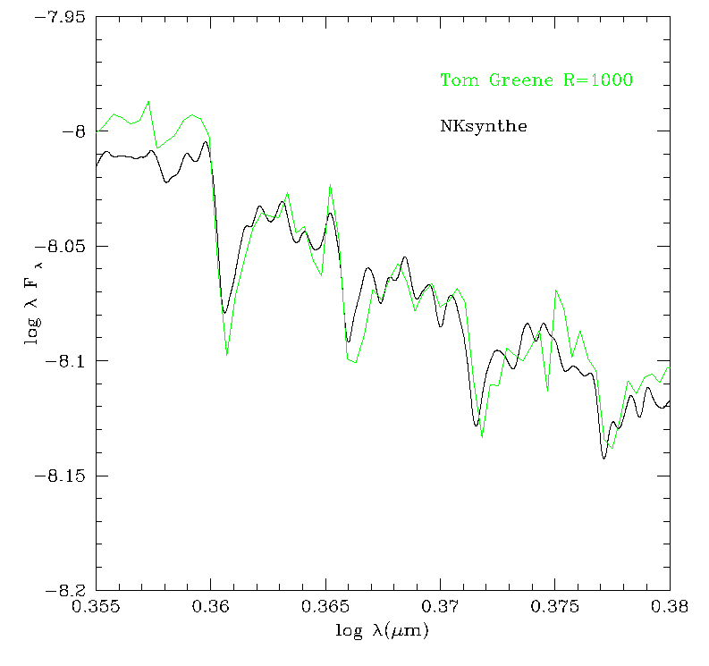
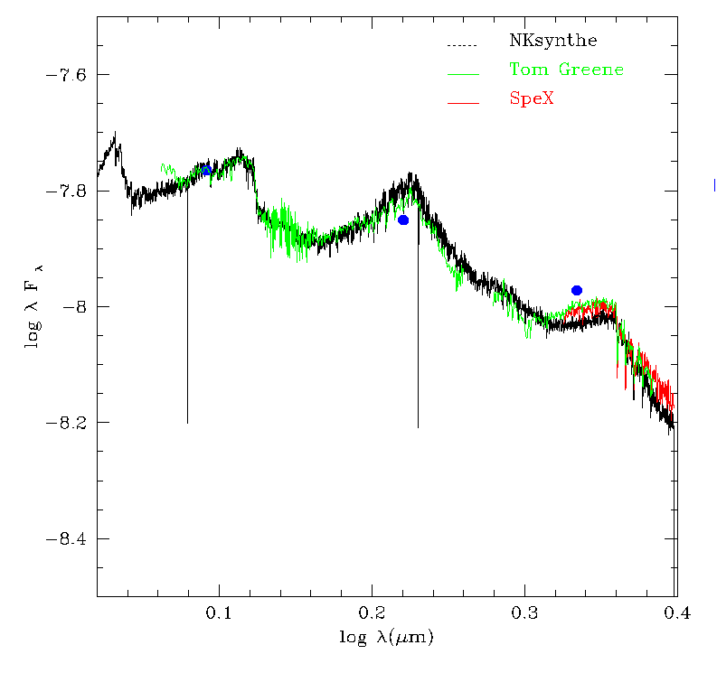
FU Ori: Hot inner disk
Tools:
Disk atmospheric radiative
transfer model
(Disk structure + Kurucz model)
(Zhu et al 2007, 2008)

Slide 6
FU Ori: Hot inner disk
Flared outer disk
(silicate emission)
High mass accretion disk
T=6000 K
0.5-1 AU
Disk atmospheric radiative transfer modeling:
Steady accretion model fits SED
The hot inner disk extends from 5 R to 0.5-1 AU
Decay timescale: t_{visc}~R²/ν
α ~ 0.01-0.1
No hot boundary layer emission
Log λF_{λ}
0.5-1 AU
(Zhu et al 2007, 2008)
Log λ (μm)
Independent constraints on hot FU Ori disk size (5 R to 0.5-1 AU):
MOST satellite suggests short small scale variability ~ 2.2-2.4 days, corresponding to the orbital time at 4.8-5.1 R (Siwak et al. 2013)
Keck Interferometer spatially resolve FU Ori to sub-AU scale, constraining the hot disk size ~0.5 AU (Eisner & Hillenbrand 2011)

Slide 7
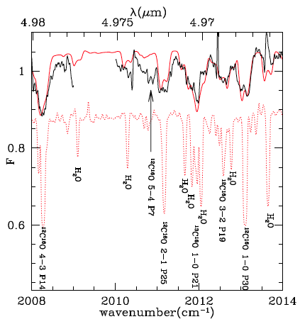
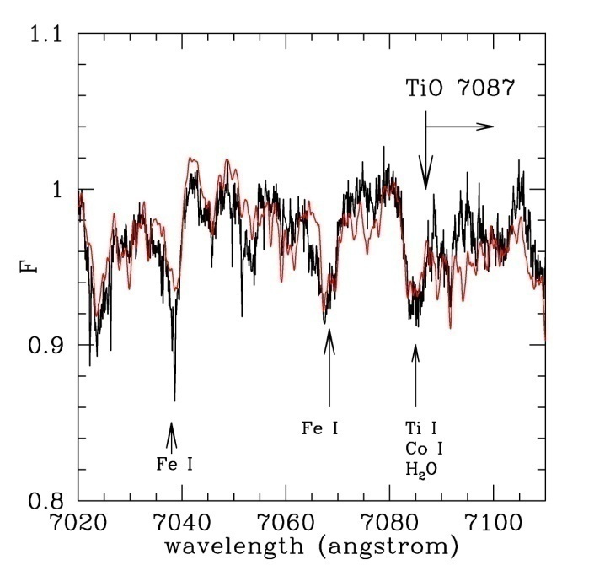
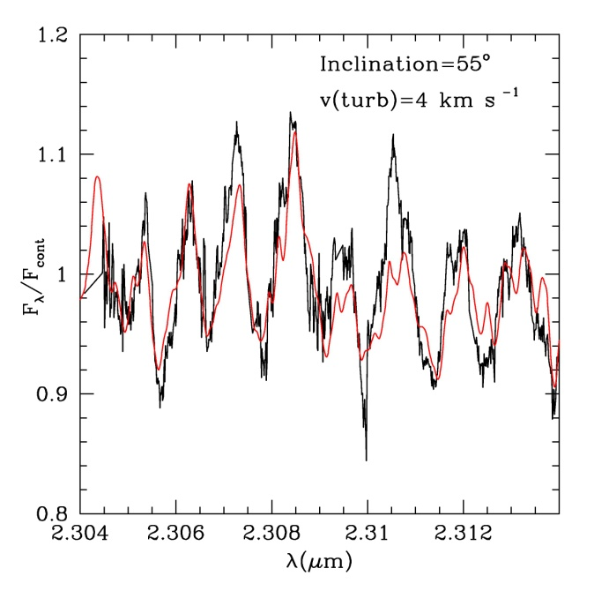
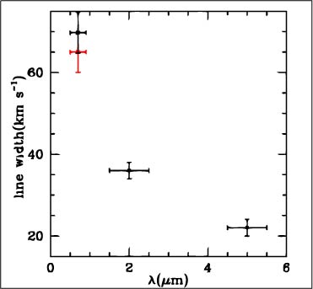
FU Ori: Keplerian rotation
2µm
5 µm
optical
Central star mass
0.3 M_{ʘ}
(Zhu et al. 2009 b)
Keplerian rotation disk
The high Ṁ disk could extend
to 0.5 AU
Produced at ~0.5 AU

Slide 8
Observation summary:
FU Ori is a high mass accretion rate disk (2x10⁻⁴ M_{ʘ} yr⁻¹) from 5 R to 0.5-1 AU around a 0.3 M star
2) Outbursts last ~100 yrs=>0.02 Msun
t_{visc}~R²/ν = decay time
α=0.02-0.2
3) Keplerian rotation disk

Slide 9
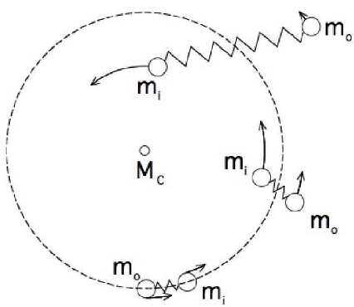
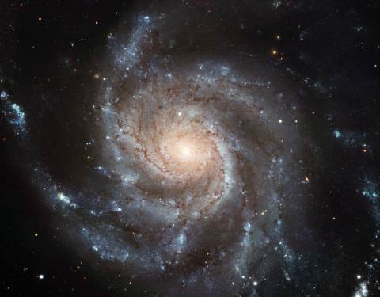

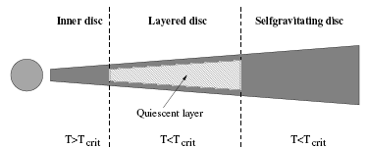
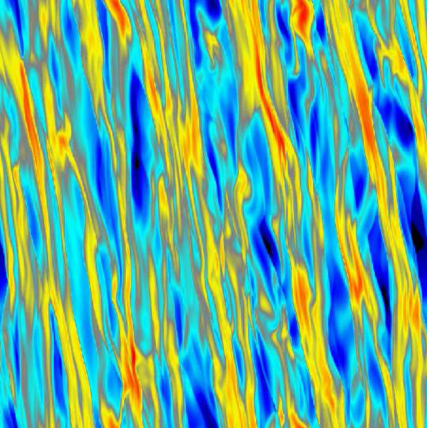
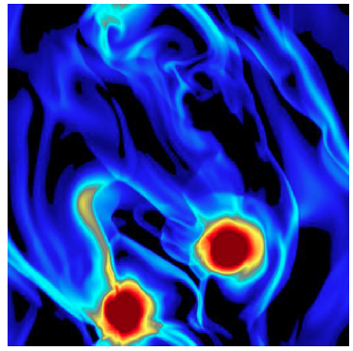
Disk accretion mechanisms (MRI & GI):
MRI
GI
~1
GI can transport angular momentum
MRI GI
High ionization ratio Toomre Q~1
α∼0.01−0.1
(Gammie 1996, Turner et al. 2007, Bai & Goodman 2009)
t_{cool}>Ω
t_{cool}<Ω
(Gammie 2001, Durisen et al. 2007)

Slide 10
Outburst and ‘S’ curve:
Log T_{eff}
`S’ curve determines the outburst
Heating<cooling
Heating>cooling
Log Σ
S curve can be due to various reasons
Hydrogen ionization-``Thermal Instability’’
successful for CV objects, proposed for FU Ori (Bell & Lin 1994)
But the outburst radius is ~0.1 AU
2) Different accretion mechanisms at different Σ and T.

Slide 11
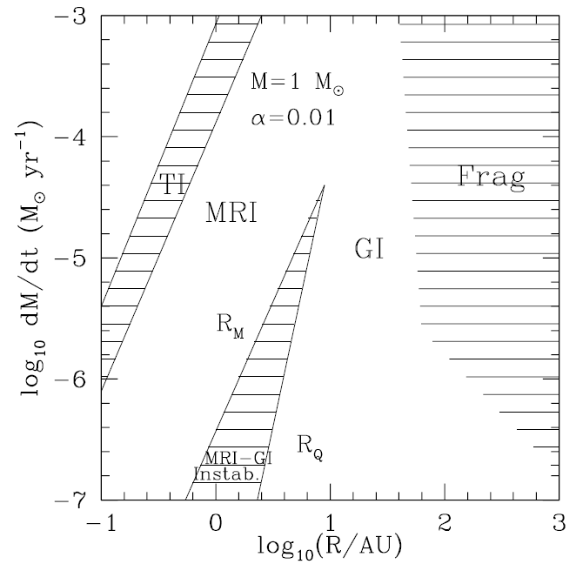
Disk unstable regions:
.
At M>3x10⁻⁵M_{ʘ}/yr
may be subject to thermal instability
(2) At M<3x10⁻⁵M_{ʘ}/yr
Non-steady (outbursts)
GI pileup->dissipation->MRI
(3) At M>10⁻⁶ M_{ʘ}/yr, R>100 AU
Gravitationally fragmentation
(Rafikov 2007, 2009)
.
.
(Zhu et al. 2009a, 2010b)

Slide 12
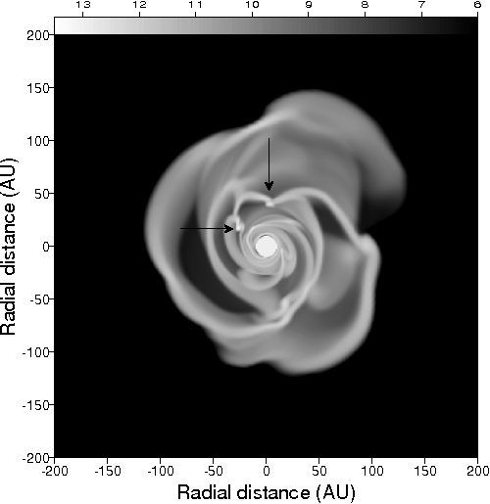
Outburst mechanisms
1) Accretion of Clumps generated by GI
Vorobyov & Basu 2005, 2006, 2008
2) Thermal instability
Bell & Lin 1994, Lodato & Clarke 2004

Slide 13
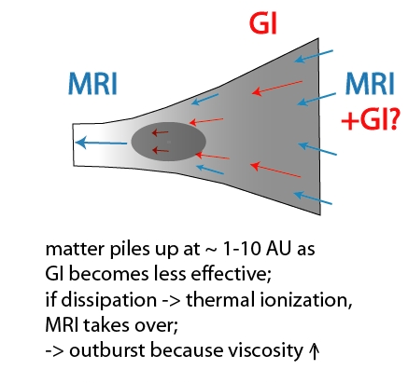
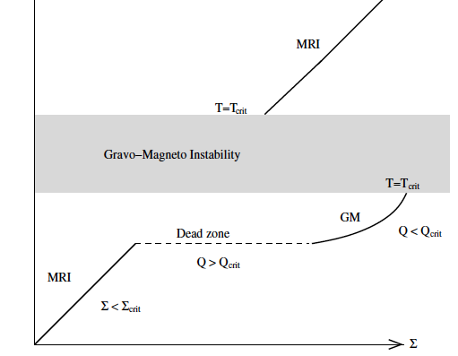
Outburst mechanism: MRI+GI instability
3) MRI+GI
GI
(Martin & Lubow 2011)
(Armitage et al. 2001, Zhu, Hartmann, Gammie 2009 a,c)

Slide 14

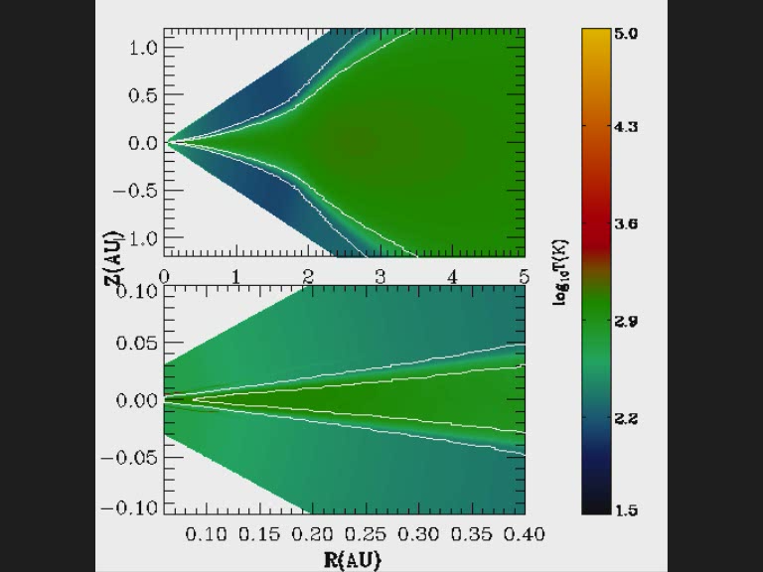
MRI+GI instability: 2D R-Z simulation
Axisymmetric viscous fluid
where the viscosity parameter (α) of MRI and GI
α= α_{MRI} if T>T_{MRI} or Σ<Σ_{A} =100 g/cm²
α=exp(-Q² )
the radiative transfer
Toomre Q

Slide 15
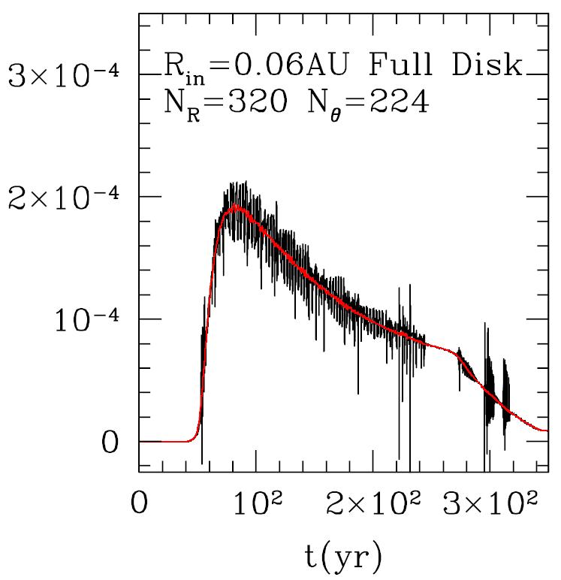
MRI+GI instability: 2D R-Z simulation
  Maximum mass accretion rate
  Outburst duration time
  High Ṁ disk size
2x10⁻⁴ M_{ʘ} yr⁻¹
dM/dt
B
(Zhu et al. 2009c)

Slide 16
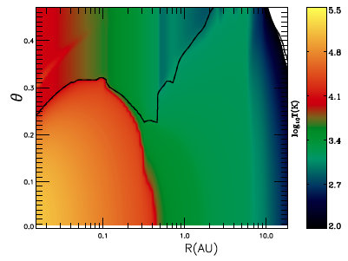
MRI+GI instability: 2D R-Z simulation
Due to Thermal instability
The midplane temperature is 10⁵ K
Hartmann, Zhu & Calvet 2010

Slide 17
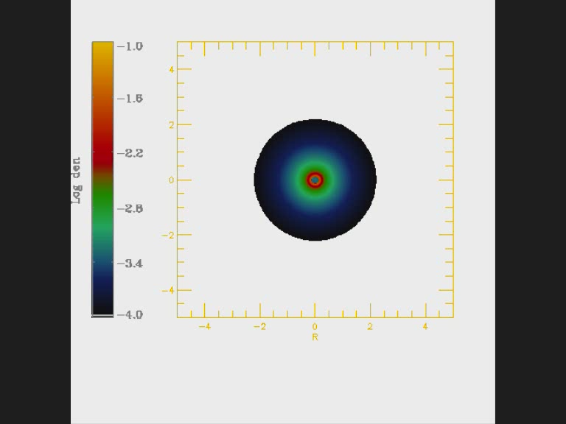
MRI+GI instability: 2D R-Φ simulation
(Bae et al. In prep.)

Slide 18
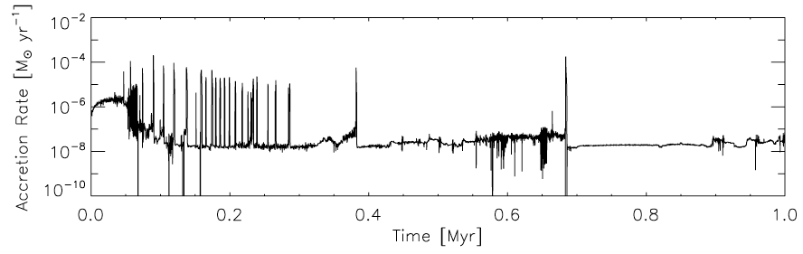
MRI+GI instability: 2D R-Φ simulation
(Bae et al in prep.)

Slide 19
Disk Fragmentation:

Slide 20
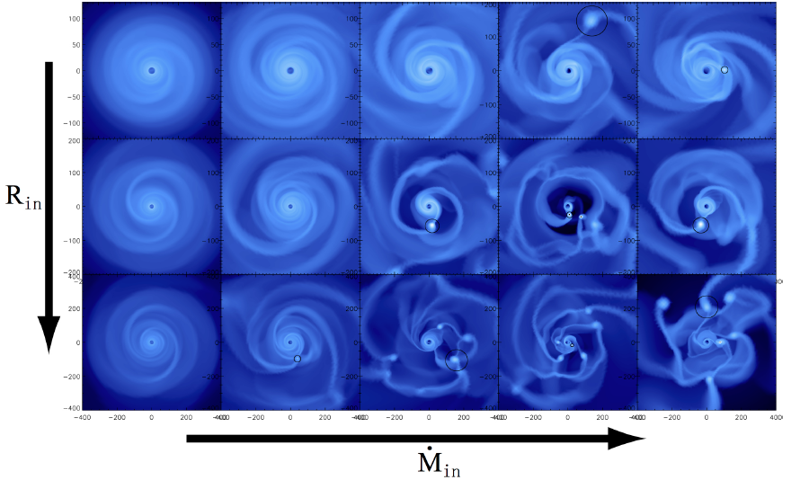
Disk fragmentation:
(Zhu et al. 2012)

Slide 21
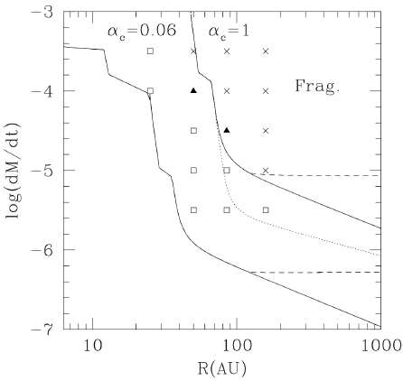
Disks fragment under certain conditions:

Slide 22
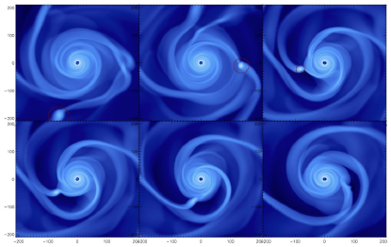
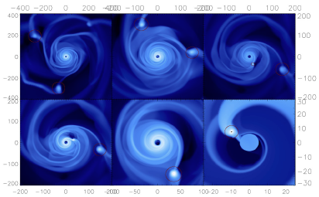
Clumps could have different fates:
Tidal destruction:
Boley 2009
Nayakshin 2010
Gap opening:
(Zhu et al. 2012)

Slide 23
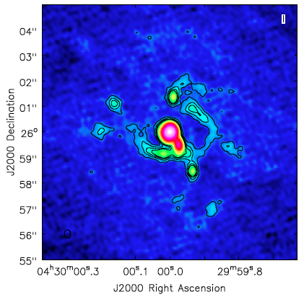
How to test various theories?
The synthetic ALMA image for a fragmenting disk.
1 minute integration with Full ALMA with 0.1” resolution
Accepted ALMA proposal for Cycle 2 (PI: Lucas Cieza):
3 FU Orionis objects and 5 Exor objects

Slide 24
Summary:
FU Ori is a high mass accretion rate disk (2x10⁻⁴ M_{ʘ} yr⁻¹) from 5 R to 0.5-1 AU around a 0.3 M star.
MRI-GI can explain the outbursts.
Disk fragments under certain conditions. Clumps could have different fates.
R*

